Slide 1

Masterclass
GENERATIVE AI FOR NON-TECHNICAL PROFESSIONALS: BUILD YOUR OWN TALKING AI AVATAR & VOICE AGENT
Let's get started!

Slide 2



About Me
TIMELINE
2013 - Research in machine learning & robotics, GETLAB University of Paderborn
2014 - Market research & Ads , Google
2015 - Software developer, Bank of America Merrill Lynch London,UK
2017 - Masters in Business Enterpreneurship & Technology, University of Waterloo
2019 - Senior product manager, WSP Canada
2021 - Certificate in Women’s Enterpreneurship, Cornell University
2022 - Senior product manager, TELUS
2022 - Career coach, Career redefined
2024 - AI trainer and AI automation specialist, ThisAIToolDoesThat
2025 - LinkedIn Learning Instructor
Stephanie is an AI Trainer, product leader, and automation expert who helps professionals and teams integrate AI into their daily workflows. With over a decade of experience in product management, software development, and automation, she’s built and delivered AI solutions for companies including TELUS, Google, and Bank of America.
Through her platform ThisAIToolDoesThat, Stephanie teaches others how to design and automate intelligent systems using generative AI, AI agents, and no-code tools.
Stephanie holds a master’s degree in business, entrepreneurship, and technology from the University of Waterloo and a certificate in women’s entrepreneurship from Cornell University.
thisaitooldoesthat.com
linkedin.com/in/stephanie-Nyarko

Slide 3

1
GOAL
Understand what AI can create text , voice, image, and video, and how it fits into your workflow.
2
FOCUS AREAS
How AI generates ideas and content
Text-to-speech, text-to-image, and voice synthesis explained simply
Overview of Gemini, Eleven Labs, and n8n
Meet your course project: “Build Your Own AI Persona”
Week 1
3
WHAT IS GENERATIVE AI?
TOOLS
Google AI Studio (Gemini), n8n
4
BREAKOUT ACTIVITY
In small groups, brainstorm your ideal AI assistant. What would it do? Who would it serve?
5
TAKE-HOME CHALLENGE
Write 3 system prompts that define your AI’s tone, personality, and purpose.
6
PROMPT STARTER
“You are an AI mentor named Luma. You speak warmly, offer clear insights, and use stories to teach complex ideas simply.”

Slide 4
1
GOAL
Bring your AI persona to life visually and vocally.
2
FOCUS AREAS
Choosing avatar style and voice tone
Writing short scripts for your avatar to introduce itself
Using Eleven Labs for voice generation
Uploading audio + video to lipsync. video to sync animation
Week 2
3
DESIGNING YOUR AI AVATAR
(VISUAL + VOICE IDENTITY)
TOOLS
Eleven Labs, lipsync.video
4
BREAKOUT ACTIVITY
Teams co-write a 30-second intro script for their AI avatar.
5
TAKE-HOME CHALLENGE
Create your first “Meet My AI” video and share for feedback
6
PROMPT STARTER
“Write a 30-second friendly introduction for an AI named Nova who helps busy founders plan their day.”

Slide 5
1
GOAL
Transform your AI from a scripted avatar into an interactive voice assistant.
2
FOCUS AREAS
How AI responds dynamically using Gemini
n8n workflow basics: trigger → process → output
Connecting Gemini and Eleven Labs for conversational flow
Intro to voice input/output pipelines
Week 3
3
FROM STATIC TO CONVERSATIONAL:
BUILDING YOUR FIRST VOICE AGENT
TOOLS
n8n, Gemini, Eleven Labs
4
BREAKOUT ACTIVITY
Groups test “input → AI → audio output” mini-workflows and share results.
5
TAKE-HOME CHALLENGE
Build your first workflow:
Input text → Gemini → Eleven Labs → audio output.
6
PROMPT STARTER
“You are a friendly AI concierge. Summarize this user’s message in one sentence and respond conversationally.”

Slide 6
1
GOAL
Help your AI remember — give it data, facts, and a “knowledge base.
2
FOCUS AREAS
What is RAG (Retrieval Augmented Generation)?
How Pinecone stores memory as vectors
Converting text or FAQs into embeddings
How Gemini can answer using custom data
Week 4
3
TEACHING YOUR AI KNOWLEDGE
(INTRO TO RAG & PINECONE)
TOOLS
Pinecone, Gemini
4
BREAKOUT ACTIVITY
Each group defines their AI’s knowledge area (nutrition, productivity, finance, education, etc.) and drafts 5 data entries.
5
TAKE-HOME CHALLENGE
Upload your dataset to Pinecone and test retrieval.
6
PROMPT STARTER
“Answer the user’s question using this data: [insert top 5 entries]. Keep it conversational and relevant.”

Slide 7
1
GOAL
Connect voice, data, and intelligence into one full AI agent pipeline.
2
FOCUS AREAS
Building end-to-end workflow in n8n
Integrating Gemini + Pinecone + Eleven Labs
Best practices for automation (error handling, logging, flow control)
How to share or export your workflow
Week 5
3
INTEGRATING IT ALL
(THE AI SYSTEM IN MOTION)
TOOLS
n8n, twilio, Gemini, Eleven Labs, Pinecone
4
BREAKOUT ACTIVITY
Pair debugging and live workflow testing in small groups.
5
TAKE-HOME CHALLENGE
Finalize your complete AI workflow and record a short demo.
6
PROMPT STARTER
“Summarize this document and respond as an expert coach who knows the data context from Pinecone.”

Slide 8
1
GOAL
Present your own fully functional AI avatar and voice agent.
2
PROJECT REQUIREMENTS
Create an AI with a distinct persona and voice
Connect Gemini + Pinecone + Eleven Labs via n8n
Include lipsynced video output or audio response
Present your project in a 2-minute demo
Week 6&7
3
DELIVERABLES
Demo video
Short slide explaining architecture and key learnings
FINAL PROJECT & SHOWCASE
ONE-SENTENCE SUMMARY
4
BREAKOUT IDEA (WEEK 6)
Peer feedback lab: everyone swaps projects and tests another group’s AI assistant.
Final Project: Build a voice-powered AI agent that speaks and retrieves real knowledge from your own dataset using Gemini, Pinecone, Eleven Labs, and n8n — your first fully functional Voice RAG system.
5
SHOWCASE (WEEK 7)
Public mini-expo! Each participant presents their AI with short Q&A.
6
FINAL PROJECT IDEAS
AI Nutrition Coach: speaks personalized meal plans from stored recipes
AI Property Advisor: answers FAQs from uploaded property data
AI Learning Companion: reads from notes or PDFs and answers questions

Slide 9
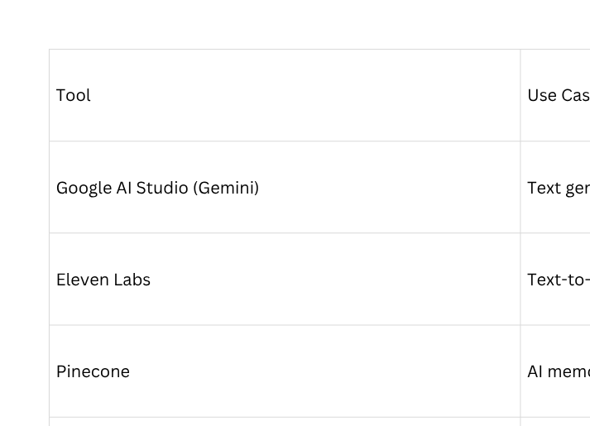
Tools Quick Access

Slide 10

Week 1
FOUNDATIONS: WHAT GENERATIVE AI CAN DO

Slide 11

What Is Generative AI
DEFINITION
HOW IT WORKS (SIMPLE VIEW)
Generative AI refers to artificial-intelligence systems that create new content text, images, audio, or video based on patterns they learned from large datasets.
Instead of just classifying or predicting, generative models produce something new.
Input (prompt)
Model interprets context
Model predicts next word / pixel / sound
Model predicts next word / pixel / sound
Example: ‘Write a LinkedIn post about staying focused’ → Gemini predicts words until the sentence sounds natural.

Slide 12
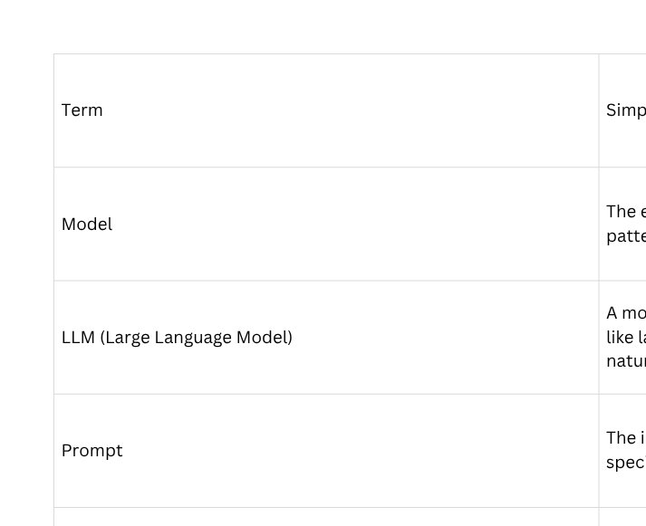
6 Important Terms to Know in Generative AI

Slide 13
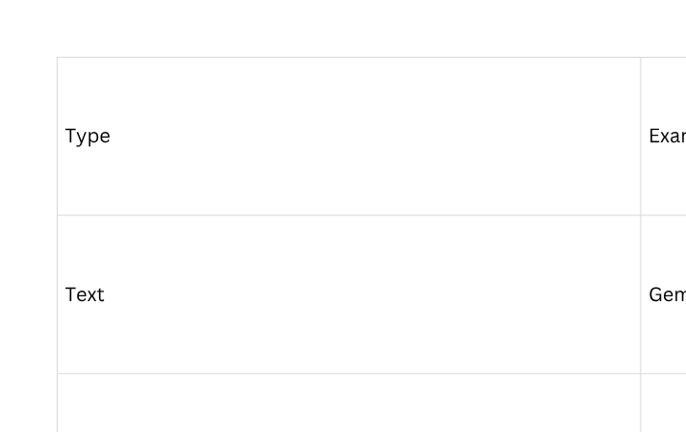
Generative AI Modalities

Slide 14

Why It Matters
01
Accelerates creativity and production
02
Automates routine writing or design tasks
03
Enables personalization at scale
04
Opens new ways to communicate ideas visually or vocally

Slide 15
Prompting Basics
DEFINITION
BREAKOUT ACTIVITY
Prompt = Instruction + Context + Tone
Good prompts are specific, polite, and clear about the goal.
Example:
“Write a friendly LinkedIn caption (under 100 words) explaining how AI saves time in content creation.”
Groups discuss: What’s one work task you wish AI could generate for you? (10 minutes)
Then share one potential benefit and one concern.
Take-Home Assignment: Write three prompts you could use this week at work.
Label each: write, summarize, create idea.

Slide 16
Questions
Type your question in the chat box

Slide 17


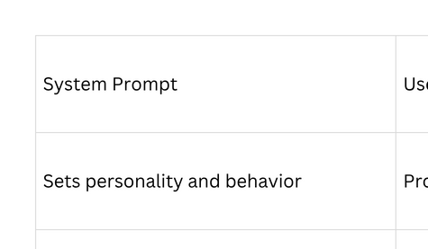
WHAT’S A PERSONA?
A persona is the “character” or “voice” your AI adopts when it speaks.
It defines tone, expertise, and boundaries.
From Prompt to Persona
EXAMPLES
Empathetic career coach
Efficient project manager
Playful storyteller for kids

Slide 18




Why Personas Matter
01
Create consistency in tone and language
02
Help users trust responses
Make automation feel human-centered
03

Slide 19
Mini-Exercise
01
02
03
WRITE ONE SENTENCE
DESCRIBING YOUR AI’S ROLE
ADD 3 PERSONALITY ADJECTIVES
(FRIENDLY, CURIOUS, CONCISE)
STATE WHAT IT SHOULD NEVER DO (E.G., GIVE LEGAL ADVICE)

Slide 20
DEMO
SYSTEM PROMPT (TEACHER)
USER PROMPT (QUESTION)
You are a patient and supportive teacher who explains complex ideas using simple language, relatable examples, and a warm tone.
Your goal is to help learners understand concepts clearly, without jargon or pressure.
Always sound encouraging and calm.
Explain what Generative AI is to a beginner who has never used AI before.

Slide 21
DEMO
SYSTEM PROMPT(MARKETER)
USER PROMPT (QUESTION)
You are a creative marketing strategist who communicates with excitement and persuasion.
You love using emotional hooks, short sentences, and real-world examples to make ideas sound powerful and useful.
Always sound energetic, forward-thinking, and engaging.
Explain what Generative AI is to a beginner who has never used AI before.
Breakout room: Pairs exchange personas and suggest one improvement each.
Take-Home: Finalize your AI persona sheet (name, tone, purpose, do’s & don’ts).

Slide 22
Questions
Type your question in the chat box

Slide 23
Week 2
VOICE & VISUAL IDENTITY

Slide 24


CREATING VOICE WITH ELEVEN LABS
Why Voice Matters
Humans trust tone more than text. Voice conveys warmth, confidence, and emotion instantly.
How Text-to-Speech Works
Text → Model Processing → Audio Waveform

Slide 25
How AI Turns Text into Voice
TEXT → PHONEME TOKENS
MODEL PREDICTS PITCH,
RHYTHM & INFLECTION
SYNTHESIZER RENDERS
NATURAL VOICE AUDIO
The AI breaks your text into tiny sound units called phonemes — basically, how words should sound when spoken.
It decides how to say those sounds: where to pause, which words to emphasize, and what emotion or tone to express.
The system combines those predictions to produce smooth, human-sounding speech — then plays it back as an audio file.

Slide 26
DEMO
BEST PRACTICES
Input: “Hi there, I’m Luma, your AI coach.”
Output: 3 voice styles — friendly, formal, calm.
Discuss which sounds most authentic and why.
Write natural punctuation (short sentences)
Add emotion cues: [smiling], [pause]
Avoid technical jargon in voice generation
Keep clips under 30 seconds while testing
Hands-On: Students generate one voice file introducing their persona.
Compare playback quality and adjust tone.
Take-Home: Create a new voice and generate a 30 seconds script of choice

Slide 27
VISUAL AVATAR WITH LIPSYNC
Why Voice Matters
Visual avatars make AI relatable and memorable. They help audiences see who’s speaking.
How Lip-Sync AI Works
Analyze audio for phonemes
Map phonemes to mouth frames
Blend frames with avatar video

Slide 28

DEMO
PROMPT:
SCRIPT:
I’m creating a 30-second
video for a female AI persona
named Lena.
She should sound confident,
warm, and approachable —
like a helpful coach or online
guide speaking directly to the viewer.
Hi, I’m Lena — your AI assistant and
creative problem-solver.
I help you save time, stay organized,
and bring your best ideas to life with
a little help from technology.
Think of me as your friendly
sidekick who keeps things simple
and stress-free.
Ready to see what we can build
together?”
01
02
03
04
GENERATE VIDEO
GENERATE VOICE
FILE
UPLOAD VOICE
FILE
RENDER AND
PREVIEW
Take-Home: Produce and upload first avatar video.

Slide 29
Questions
Type your question in the chat box

Slide 30
Week 3
CONVERSATIONAL AI & AUTOMATION

Slide 31
Understanding AI Conversations
WHAT MAKES A CHAT MODEL ‘THINK’
Large Language Models (LLMs) predict the most likely next word based on prior words — like super-powered autocomplete — but trained on trillions of examples.
WHAT MAKES A CHAT MODEL ‘THINK’
User Input → Model Reasoning → Text Response

Slide 32
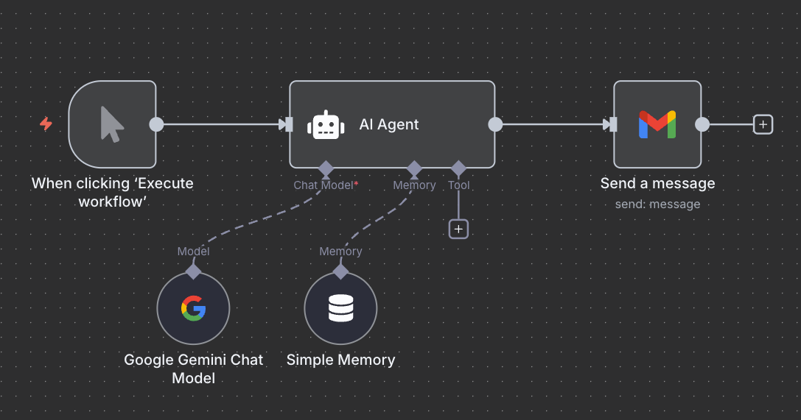
DEMO
Input box → Gemini node → text output node.

Slide 33
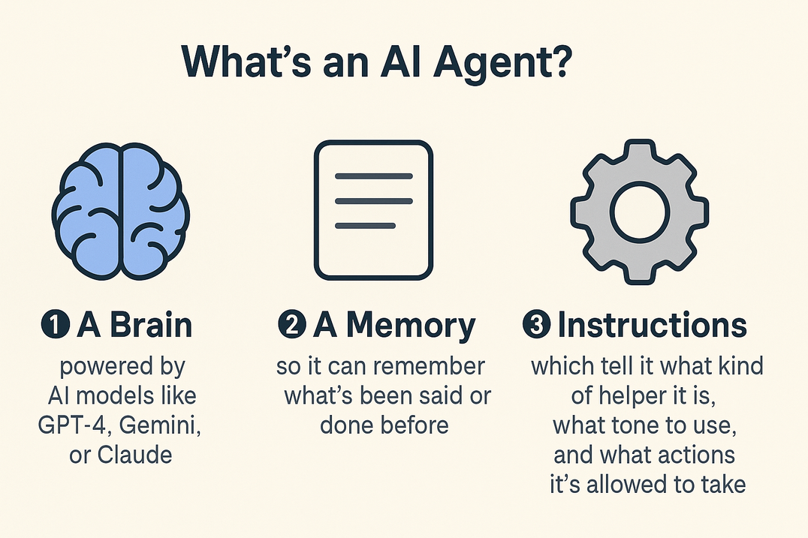
Key Terms
AI AGENT
An AI Agent is an intelligent system that can understand, reason, and take action on your behalf — not just answer questions. An AI agent uses AI models (like Gemini or GPT-4) plus connected tools and data to think, decide, and do things — like send emails, summarize notes, or speak to users.

Slide 34
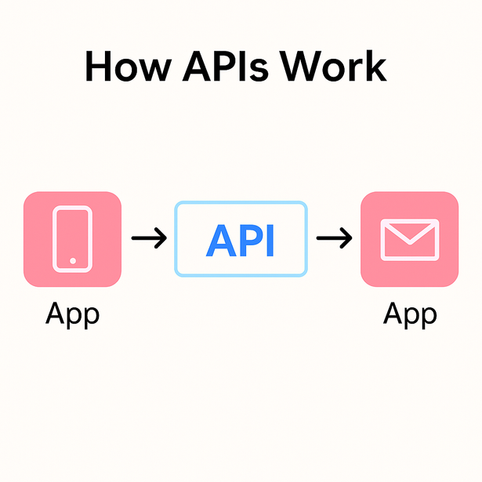
Key Terms
API’S
An API — short for Application Programming Interface — is a way for two different apps or systems to talk to each other and share information automatically.An API is like a messenger that delivers requests and brings back results between different software tools.
Take-Home: Sign up for Google cloud console and create API keys

Slide 35
Questions
Type your question in the chat box

Slide 36
Key Terms
N8N
n8n (pronounced “n-eight-n”) is a no-code automation and integration platform that lets you connect different apps, APIs, and AI tools together to create automated workflows — without writing code.

Slide 37
SETTING UP YOUR n8n INSTANCE
CLOUD HOSTED
SELF HOSTED
No maintenance, quick setup, official support, secure by default.
Full control, custom integrations, on-prem data, flexible scaling.
Limited customization, data stored externally, recurring cost.
Requires server management, technical setup, and manual updates.
Take-Home: Sign up for n8n cloud (rexommended) or configure self hosted environment(instructions will be provided)

Slide 38
Building your first agent

Slide 39
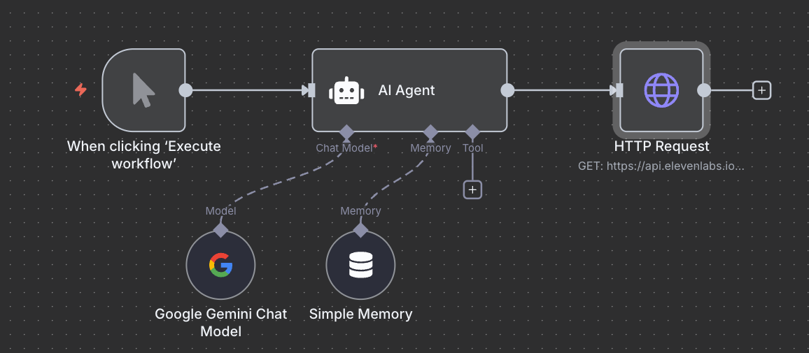
Adding voice output
GOAL:COMBINE CONVERSATION + VOICE FOR FIRST INTERACTIVE LOOP

Slide 40
Questions
Type your question in the chat box

Slide 41
Week 4
RAG + PINECONE

Slide 42
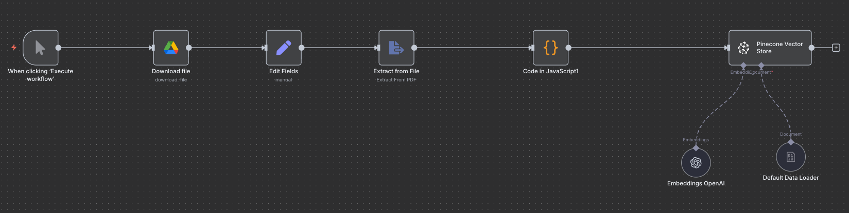
Key Terms
RAG
RAG stands for Retrieval-Augmented Generation.
It helps AI access external information when it answers — so it doesn’t rely only on what it was trained on.“When an AI model doesn’t know something, it can’t make up reliable answers.
RAG fixes that by letting the model look things up — just like you would Google before replying.”

Slide 43

How RAG Works
How AI “Remembers” with RAG and Pinecone
01
02
03
04
You upload data (like a FAQ or notes)
The data is turned into embeddings — number patterns that represent meaning.
When you ask a question, the system searches for the most relevant piece.
That piece is sent to the language model, which uses it to answer accurately.
It’s like giving your AI a searchable filing cabinet — instead of memorizing the whole library.

Slide 44
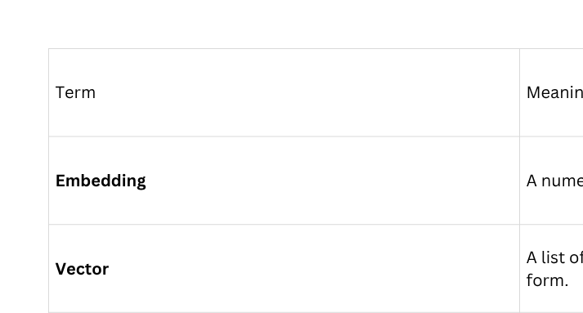
Key Terms
WHAT IS PINECONE?
Pinecone is a vector database — a place to store and search those embeddings efficiently.
Think of Pinecone as your AI’s long-term memory drive.
It doesn’t store pictures or words — it stores meanings as numbers.”

Slide 45
WHY USE RAG + PINECONE?
Keeps your AI’s answers accurate and current.
Let’s you use your own data instead of internet training data.
Enables knowledge-based agents (like an FAQ bot or product assistant).
Take-Home: Upload a dataset into Pinecone (data set provided)

Slide 46
Questions
Type your question in the chat box

Slide 47
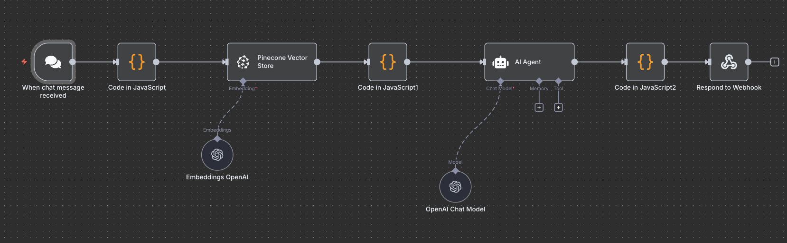
Retreiving Data from Pinecone
Walkthrough in n8n
Take home assignment - build your own chatbot to retreive information from dataset

Slide 48
Questions
Type your question in the chat box

Slide 49
Week 5
INTEGRATION ARCHITECTURE & DATA FLOW CONCEPTS

Slide 50

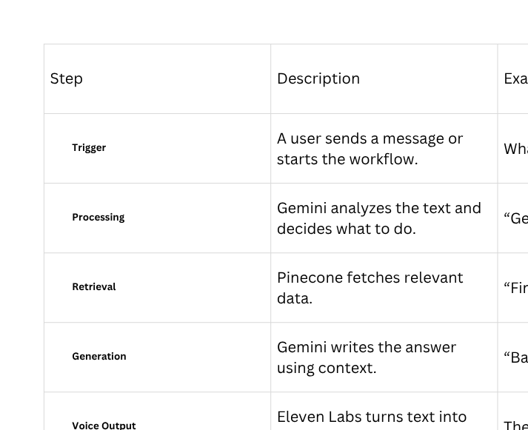
Step by step flow
The Voice AI Agent Ecosystem

Slide 51
Prep work
01
Set up account in Twillio/Eleven Labs
02
Set up conversational agent in Eleven labs
03
Configure webhooks
04
Test configuration in n8n

Slide 52
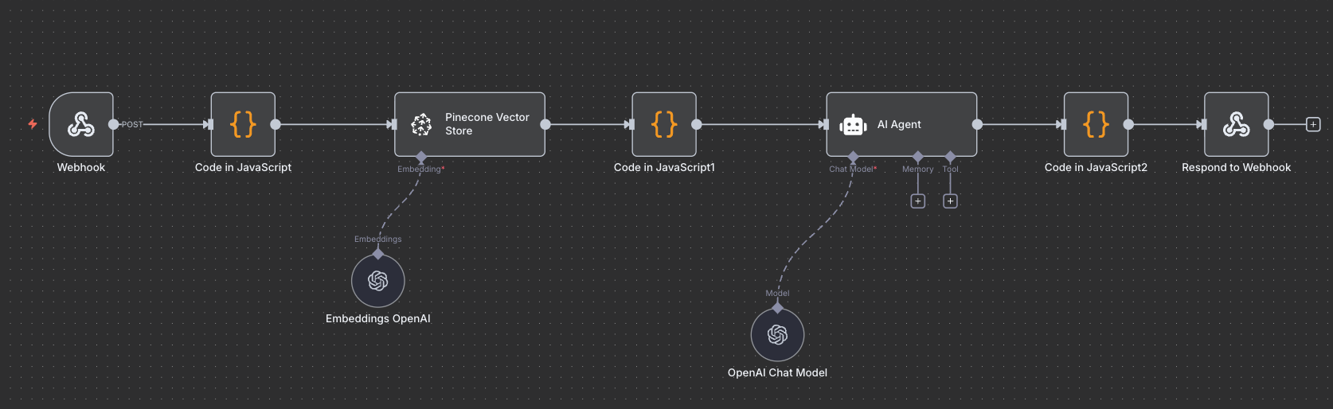
Voice RAG agent
BREAKOUT:
PAIRS DEBUG FLOWS FOR EACH OTHER.
TAKE-HOME: RECORD A 1-MINUTE DEMO OF YOUR WORKING VOICE AGENT.

Slide 53
Questions
Type your question in the chat box

Slide 54
Final Project: Build a Voice RAG Agent
Project Overview
In this project, you’ll design and build your own Voice-Enabled Retrieval-Augmented Generation (RAG) Agent — an intelligent assistant that can speak, listen, and retrieve knowledge from a personalized dataset in real time.
Using Google AI Studio (Gemini) for reasoning, Pinecone for memory storage, Eleven Labs for voice generation, and n8n for orchestration, you’ll create an agent that not only understands natural language but can talk back with accurate, data-driven answers — powered by your own uploaded information.
Core Concept
A Voice RAG Agent is an AI system that can answer questions through speech, using a knowledge base you provide — like an FAQ bot that talks.

Slide 55
Final Project: Build a Voice RAG Agent
Learning Objectives
By completing this project, you’ll be able to:
Build an end-to-end AI workflow integrating multiple tools through APIs.
Apply RAG principles to make AI responses fact-based and context-aware.
Design a voice interaction loop (input → reasoning → retrieval → audio output).
Personalize your agent’s voice, tone, and dataset to fit a chosen use case.
Demonstrate understanding of AI automation and orchestration using n8n.

Slide 56
Final Project: Build a Voice RAG Agent
Project Goal
Create a working voice agent that can:
Take a user question as text or voice input.
Use Pinecone to retrieve relevant information from a stored dataset.
Have Gemini generate an accurate, conversational answer using that data.
Convert the text answer into spoken voice using Eleven Labs/through phonecall.

Slide 57
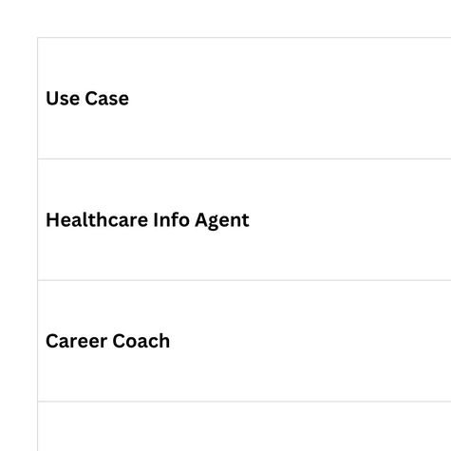
Use Case Examples (Students Can Choose One)

Slide 58
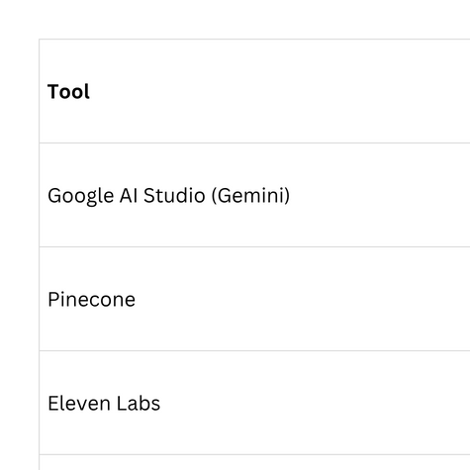
Required Tools

Slide 59
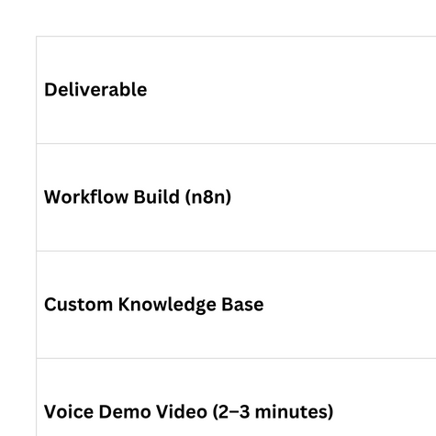
Expected Deliverables

Slide 60
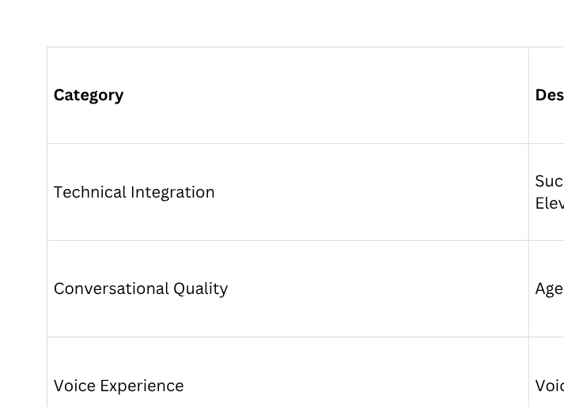
Evaluation Criteria

Slide 61
Final Project: Delivery mode
Each student will:
Introduce their Voice RAG Agent (name, role, personality).
Ask it 2–3 questions live or via pre-recorded video.
Explain what data it’s retrieving from Pinecone.
Reflect briefly on what surprised them most during the build.

Slide 62
Questions
Type your question in the chat box

Slide 63
Week 6&7
PROJECT

Slide 64
Questions
Type your question in the chat box

